Slide 1

JUMIA SALES DATA ANALYSIS
EXCEL ASSIGNMENT

Slide 2
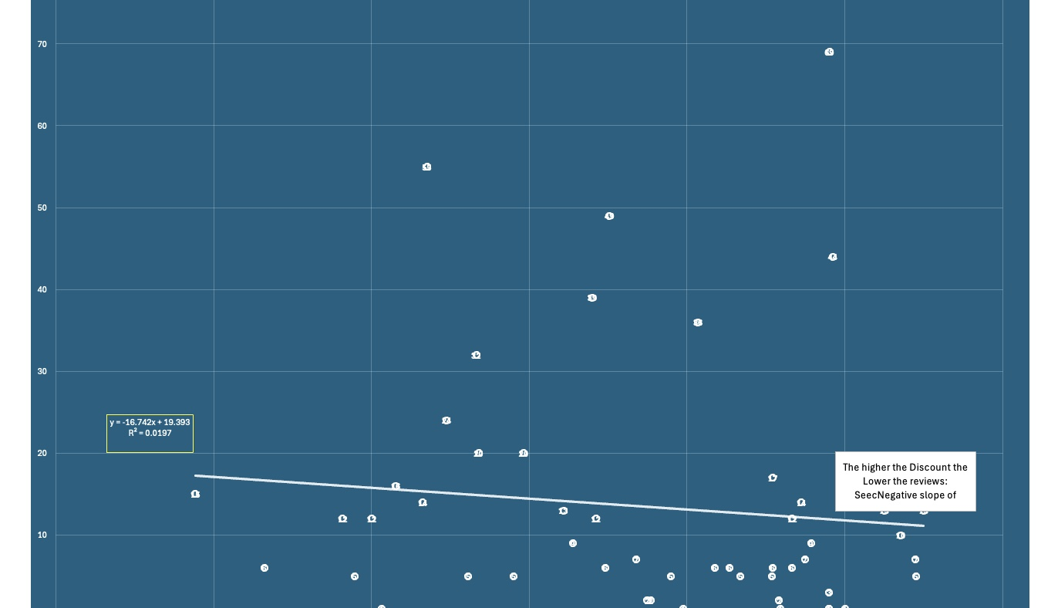
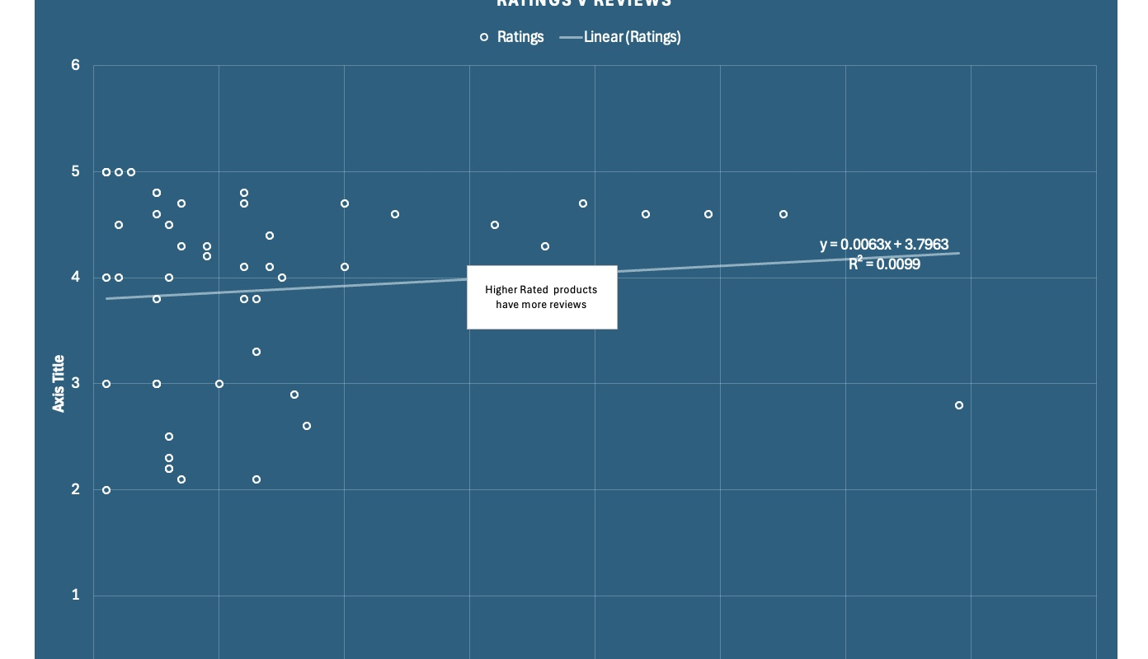
TREND ANALYSIS FOR THE DATA

Slide 3
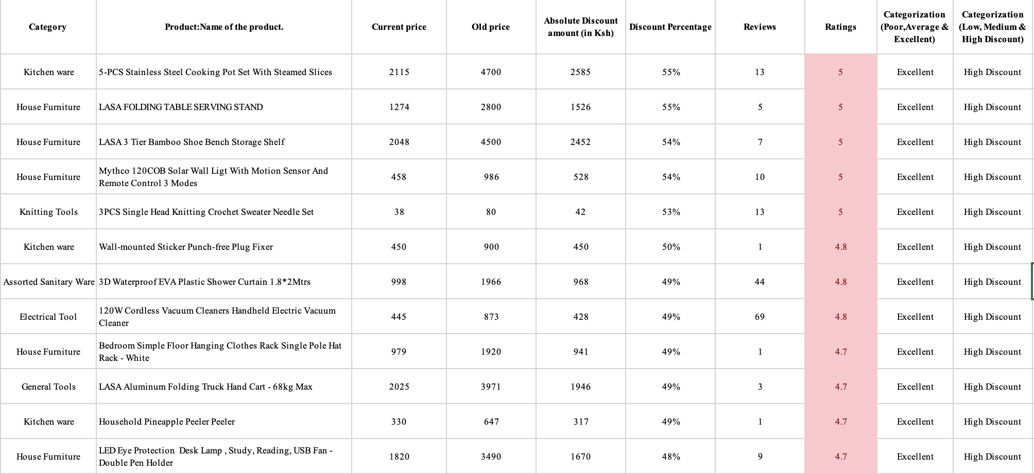
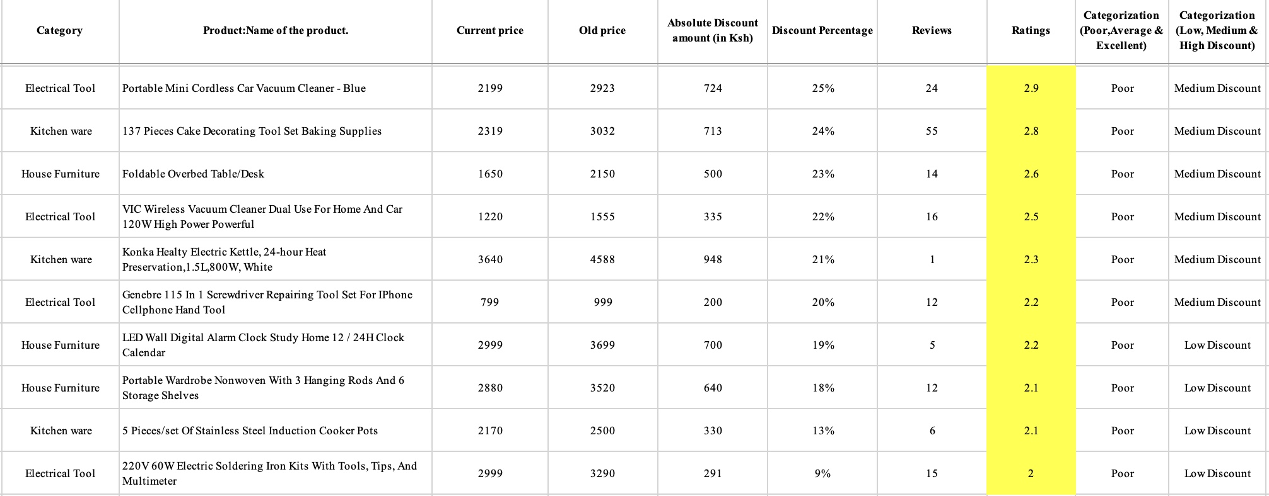
TOP 10 & BOTTOM RATED PRODUCTS

